Slide 1



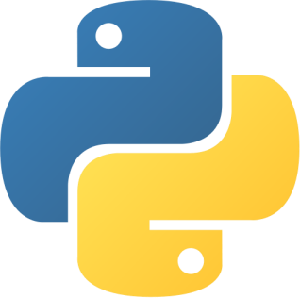
CODING WITH PYTHON
A COURSE FOR ABSOLUTE BEGINNERS

Slide 2
INSTRUCTOR CONTACT
Sajid Majeed
(sajidmajeed.ist@gmail.com)
We will try to cater to all queries within class timings, but if you feel there is something you need help with later, or were not able to ask during the session, please feel free to drop me an email, and I will get back to you as soon as I can.

Slide 3
WHY LEARN TO PROGRAM ?

Slide 4
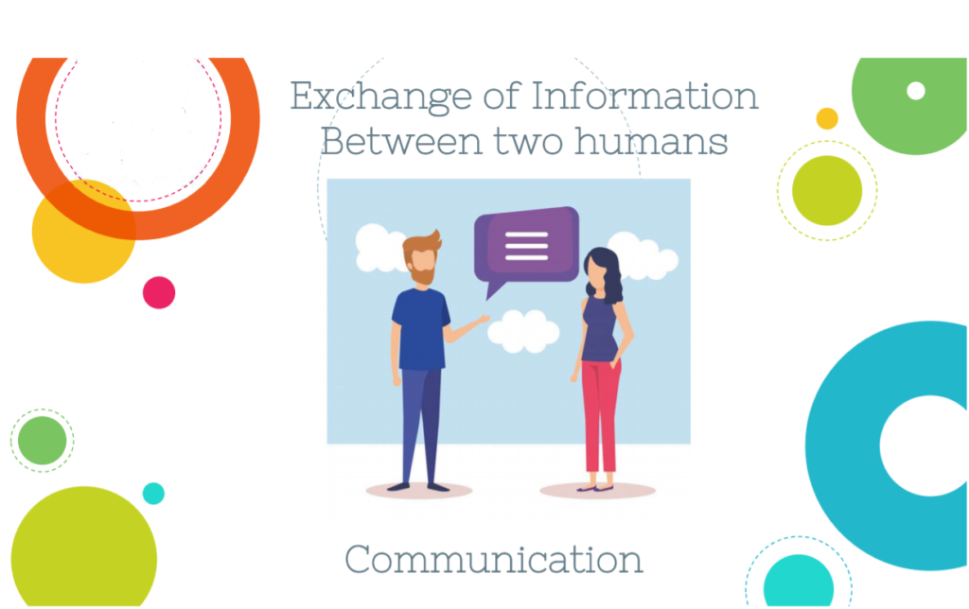

Slide 5
CODING IS A 21ST CENTURY SKILL !
Coding is the method of giving a computer instructions to perform a specific task.
These instructions are communicated using a language that computers can understand.
Learning to code at a young age is a great opportunity for teens and young adults to develop their problem-solving and critical thinking skills.
It also instills the necessary focus and organization to see projects through to completion.
It motivates youngsters to become makers of technology while preparing them for countless job opportunities.

Slide 6
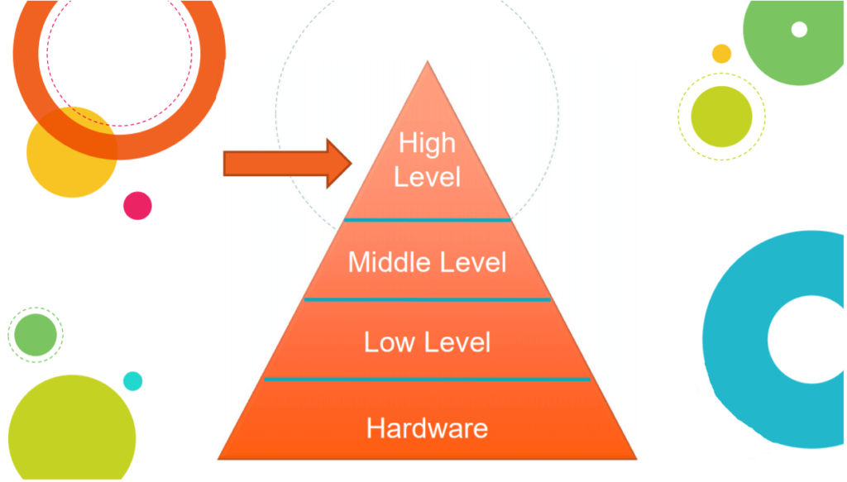

Slide 7
INTRODUCTION TO PYTHON

Slide 8
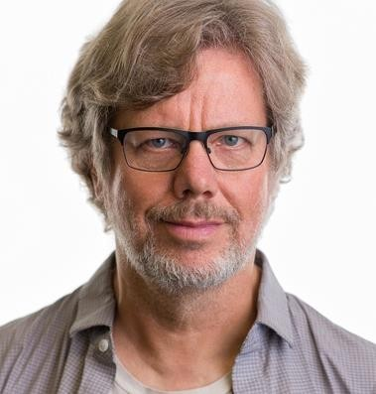
WHO CREATED PYTHON ?
Created in the 1980s by a dutch programmer, Guido Van Rossum, who was working then at the National Research Institute for Mathematics & Computer Science in the Netherlands.
As a hobby, he started developing a language that would use indentation instead of braces, making the code more readable.
Python was officially released in 1989
The name inspired by his favourite
Python’s Flying Circus”
show
“Monty

Slide 9


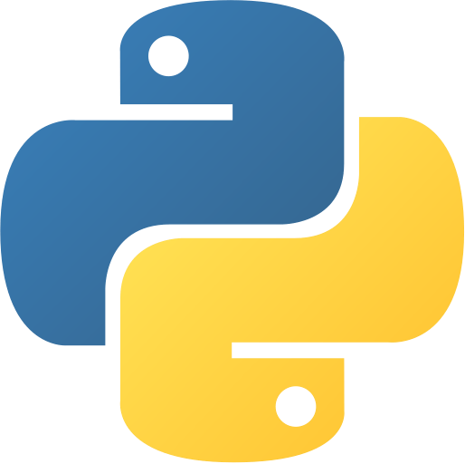
FEATURES OF PYTHON
User-friendly
Open-Source
Python’s syntax is very simple. It’s much like writing in English.
Hence, it is easy to read (and understand) and write code in Python.
Object-Oriented
Python code is also concise.
High-Level
Requires fewer lines of code to perform the same functions as compared to other languages.
Interpreted
This makes developers faster and more productive.
Large Library

Slide 10
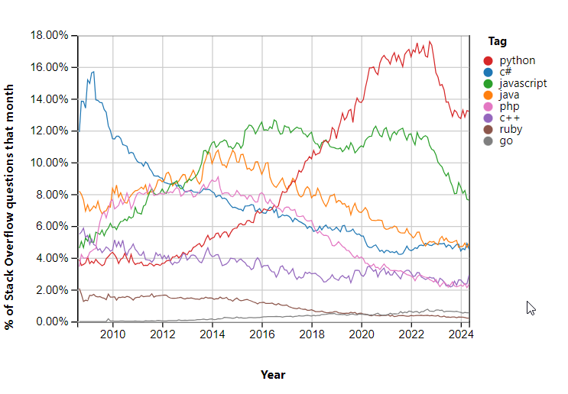
RISE TO POPULARITY

Slide 11
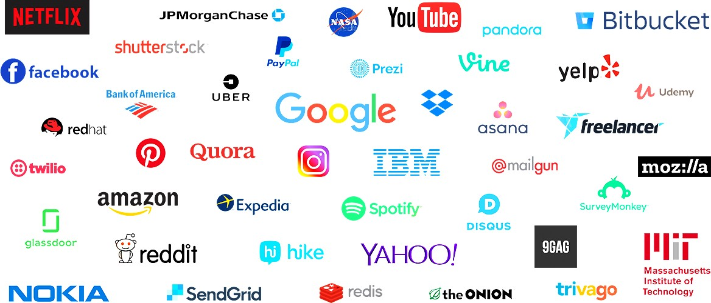
SOME TOP COMPANIES USING PYTHON

Slide 12
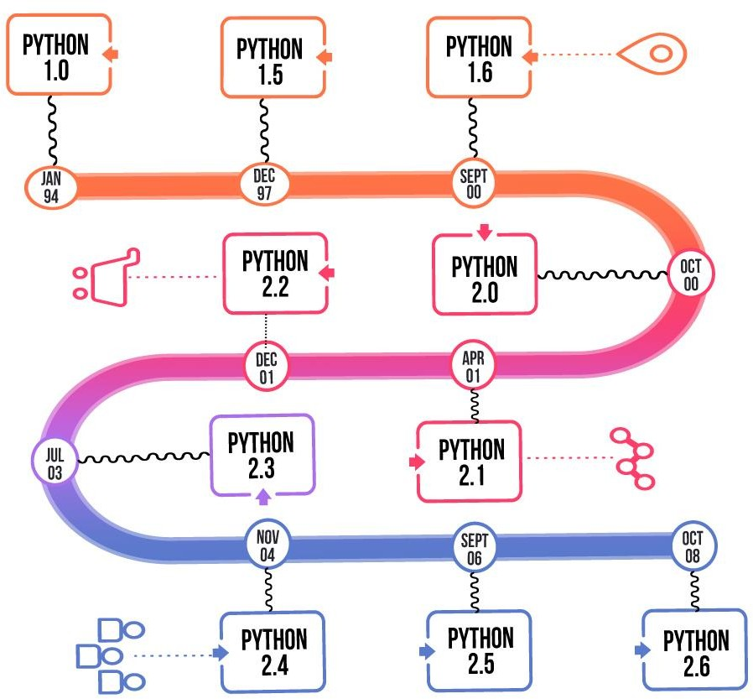
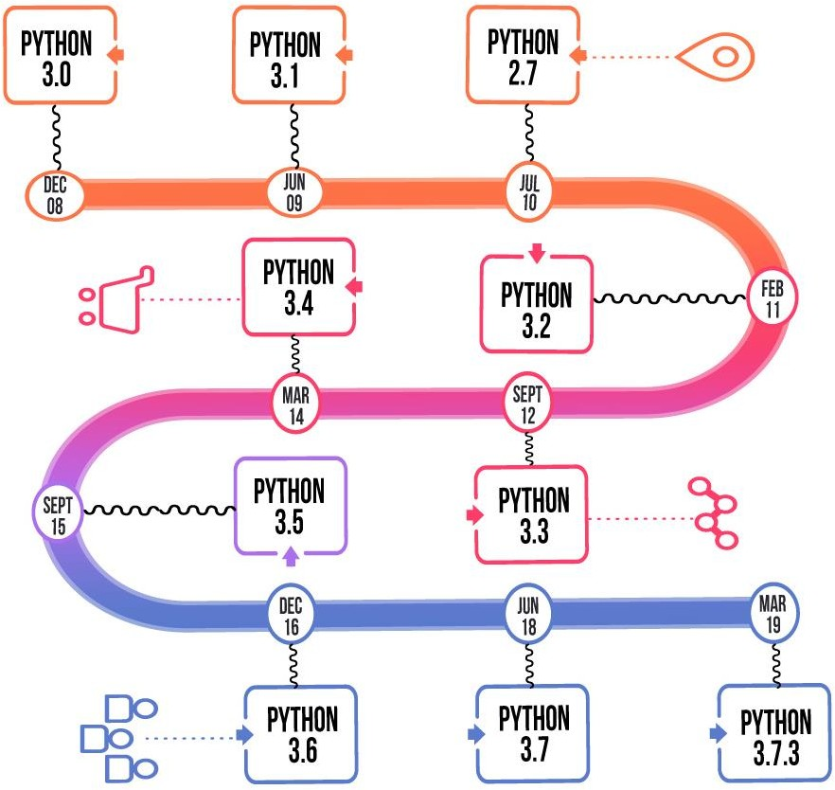
* Current version Python 3.13

Slide 13
APPLICATIONS OF PYTHON

Slide 14

PYTHON APPLICATIONS
Scripting
Data Science
Python has significantly evolved since its creation.
Facilitates building a plethora of apps.
Machine-Learning
Python is a language that does it all, from web applications to video-games, Data Science, Machine Learning, real- time applications to embedded applications, and so much more.
Web Development
GUI & GAMES
Robotics

Slide 15
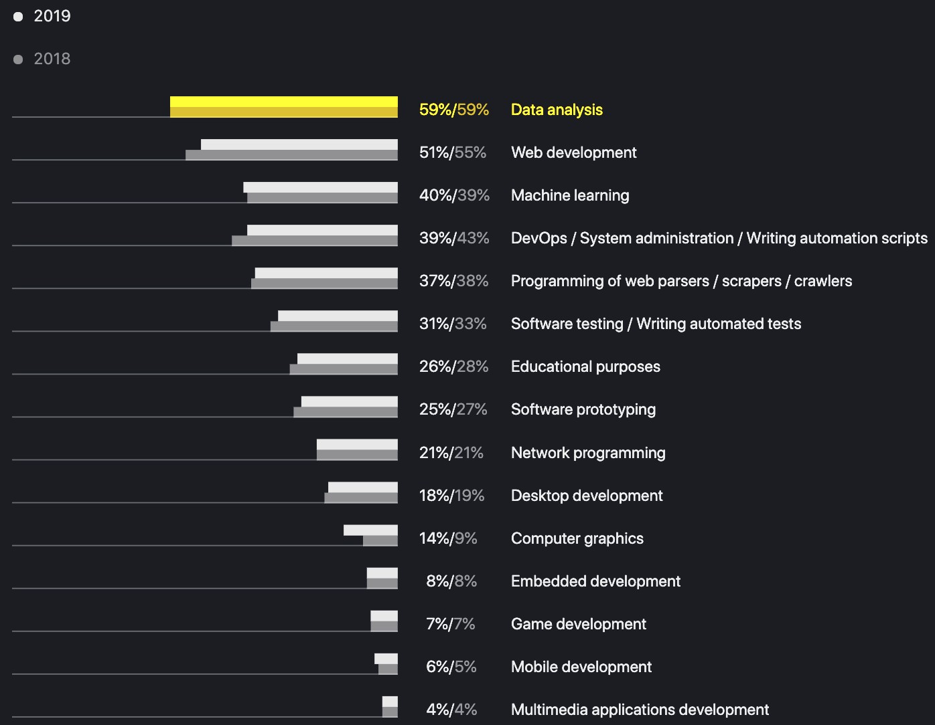

Slide 16
MYTHS & MISCONCEPTIONS

Slide 17
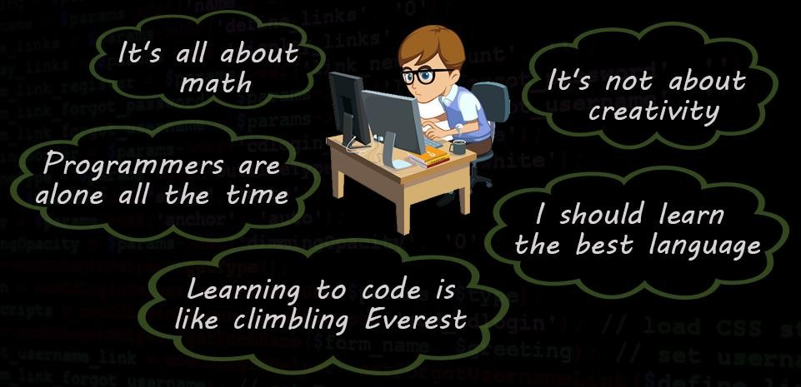

Slide 18

Python is difficult and time-consuming
It is a skill for smart people who are amazing at Maths
Not compiled and used only for scripting
Python is slow
Python is not for big projects
Python is not for secure, critical systems
Python lacks support

Slide 19
INSTALLING PYTHON ON WINDOWS MACHINES

Slide 20
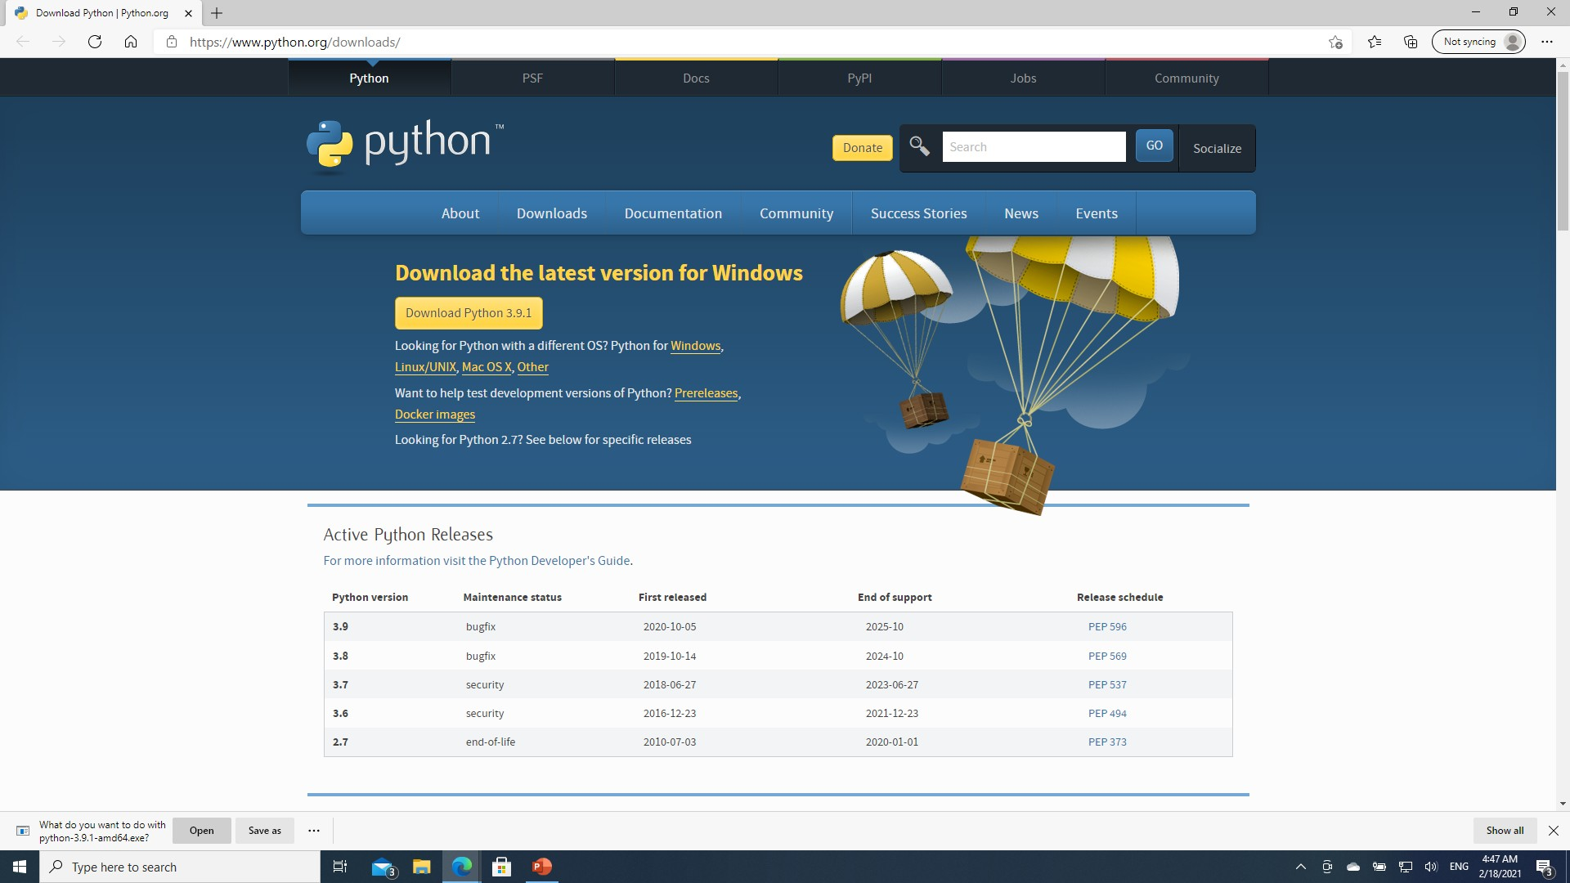

Slide 21
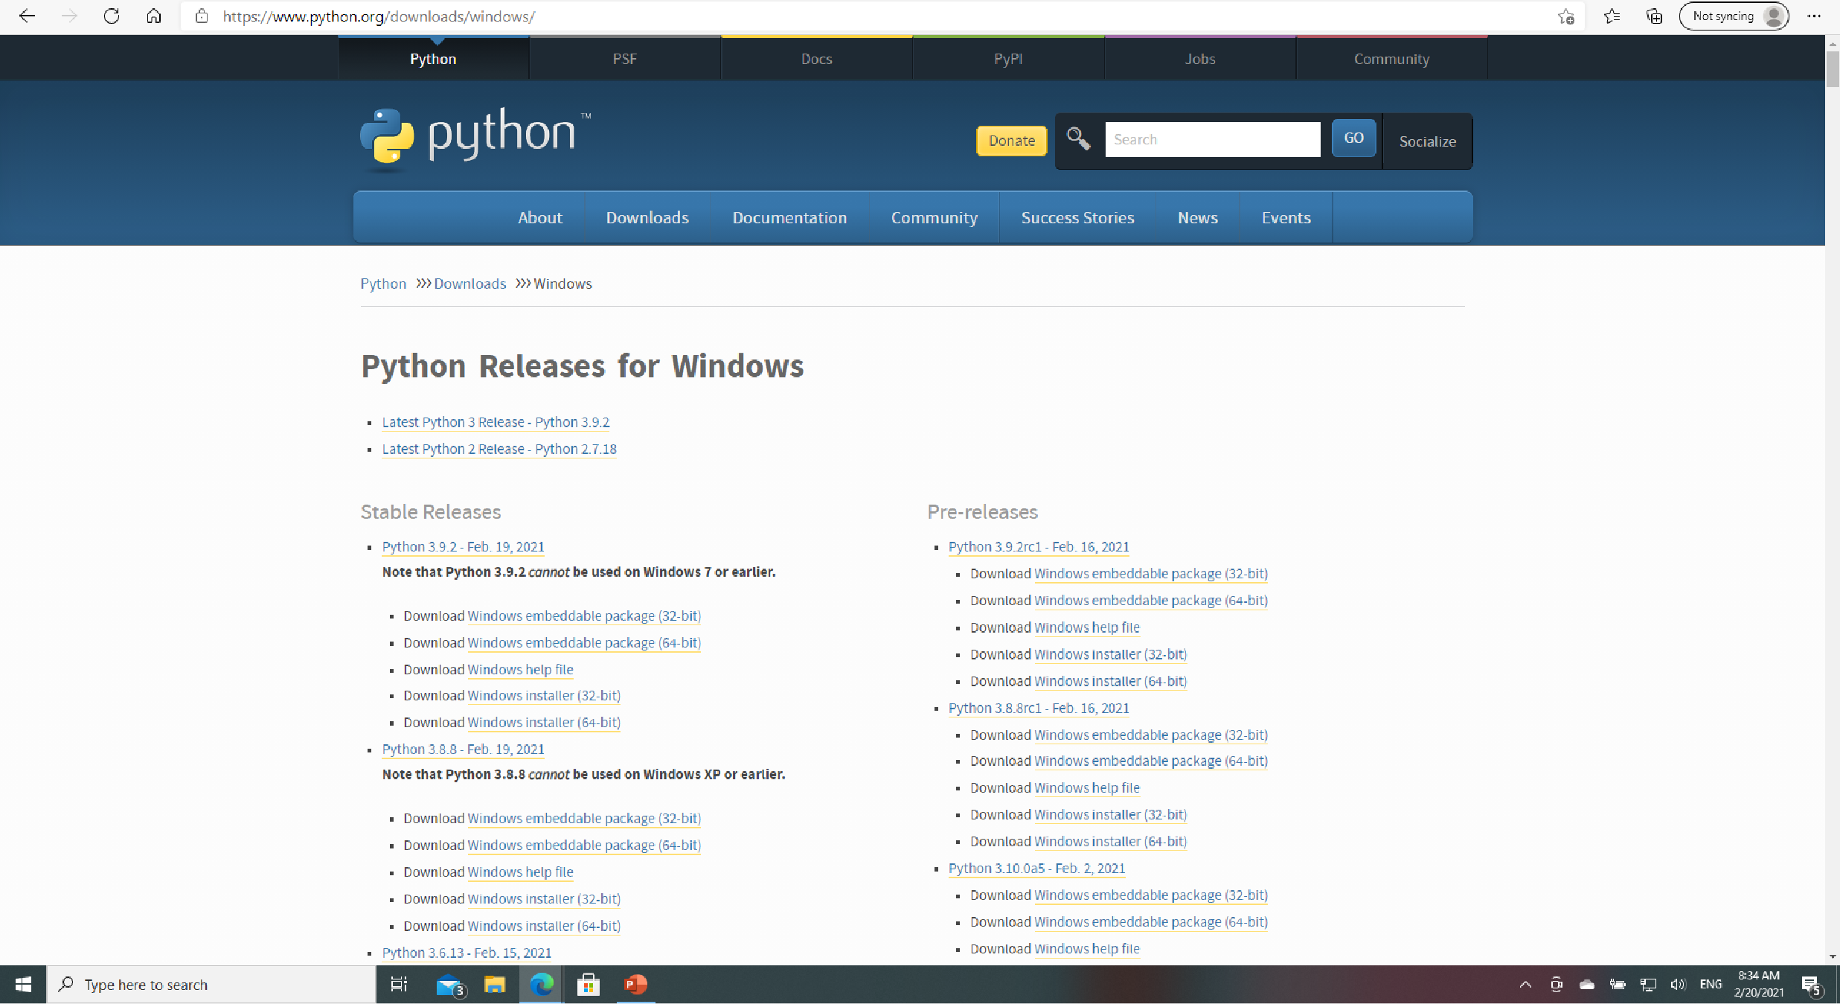

Slide 22
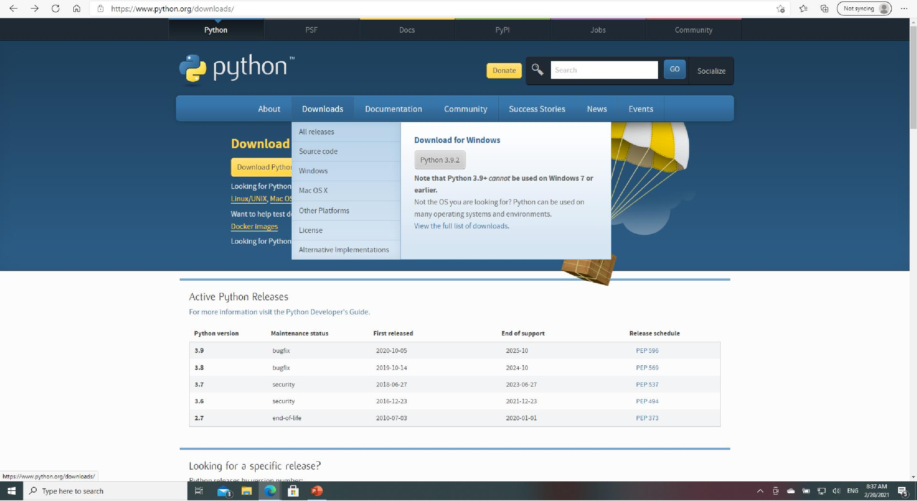

Slide 23
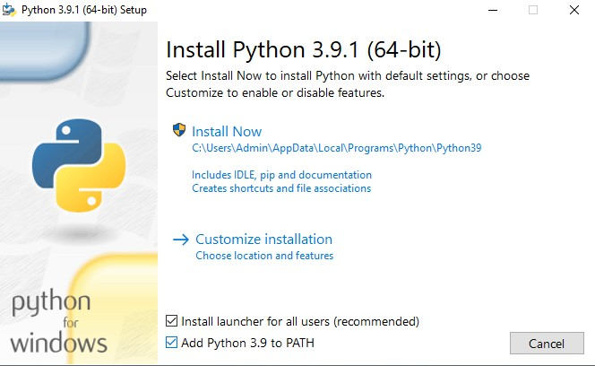
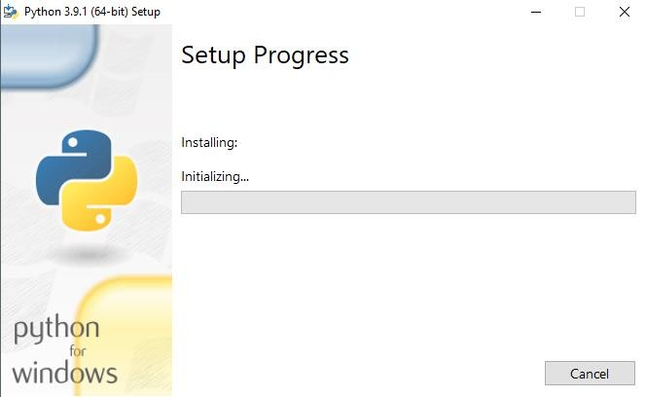
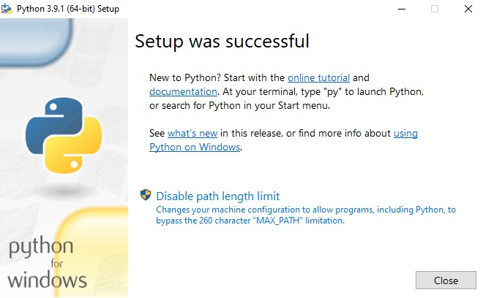
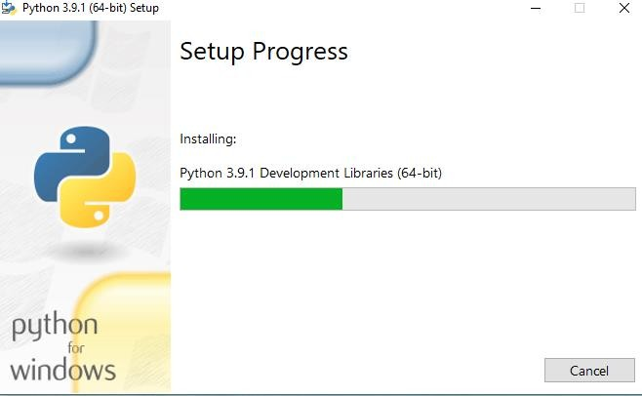

Slide 24
Check PYTHON version using command prompt (cmd)

Slide 25
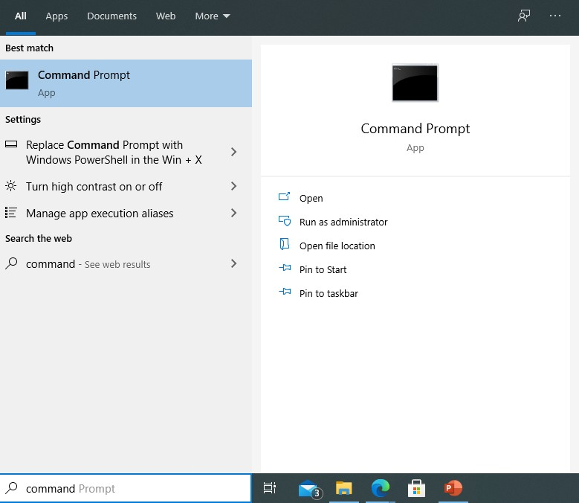
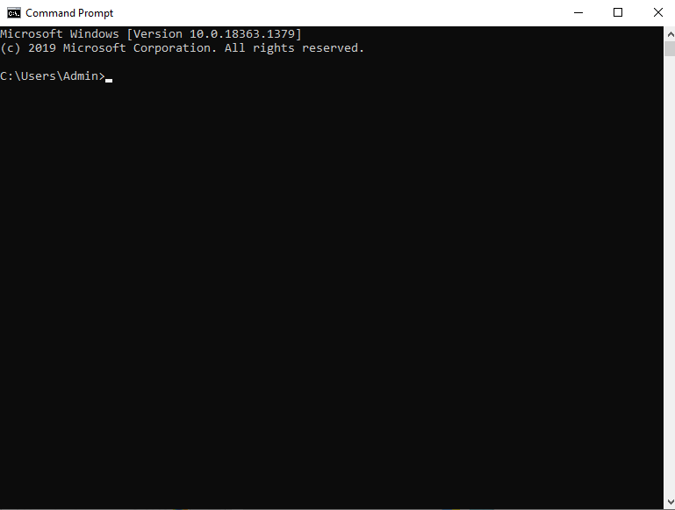

Slide 26
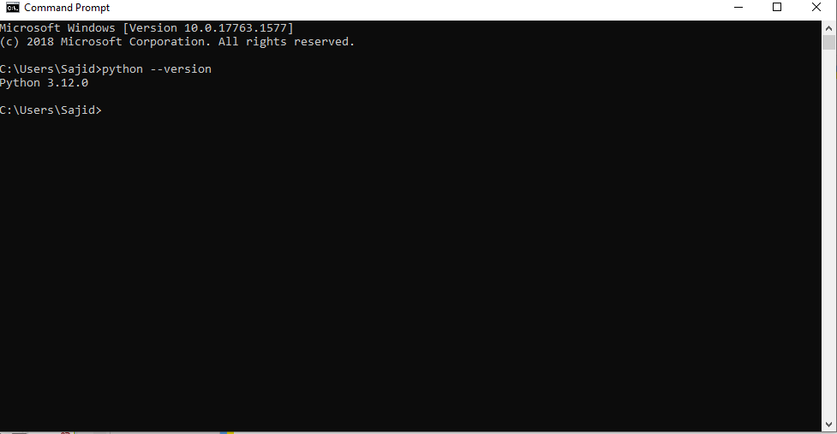

Slide 27
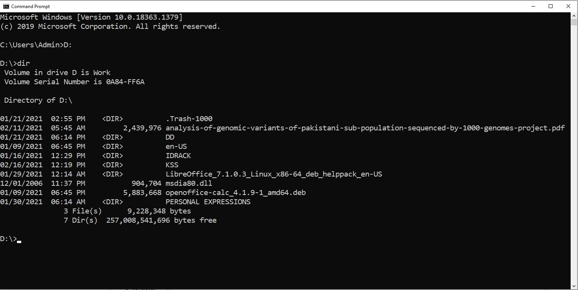

Slide 28
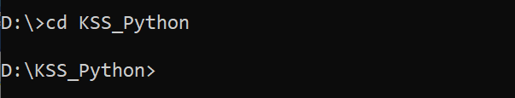
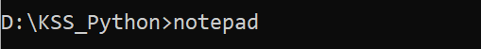
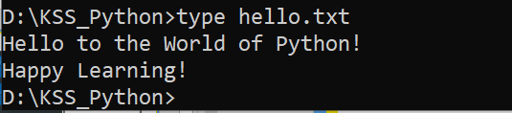
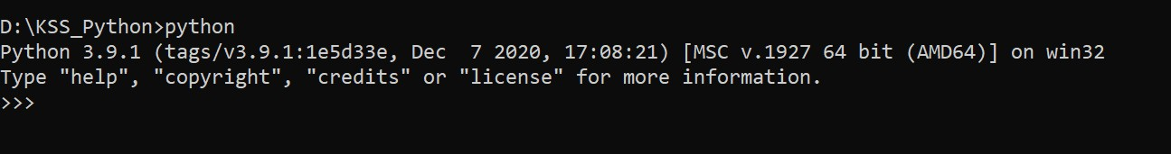
Make a new Directory
Change Directory
Open NotePad
View File Contents
Python Shell

Slide 29
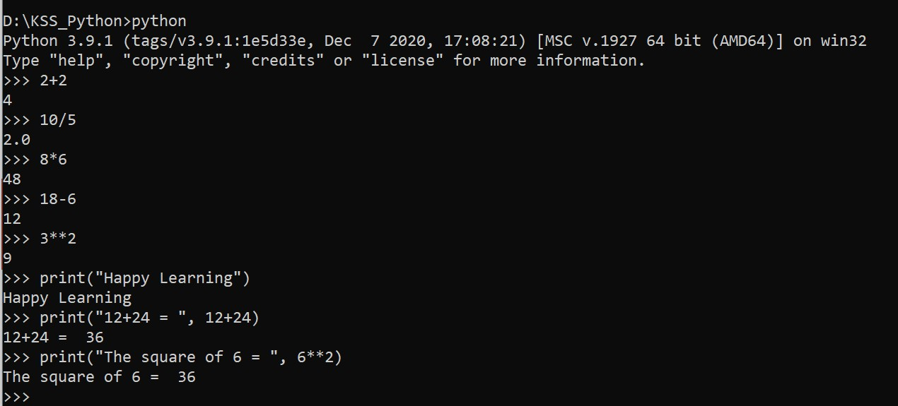

Slide 30
IDLE
(Integrated Development & Learning Environment)

Slide 31
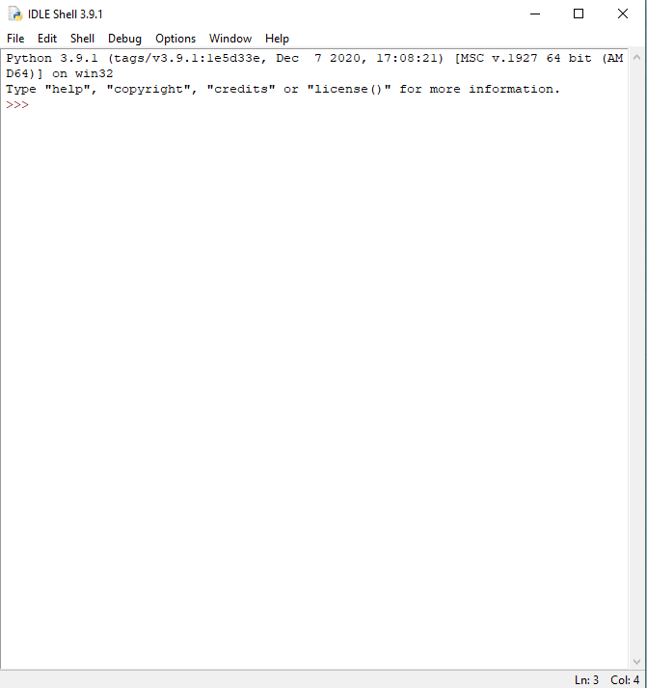
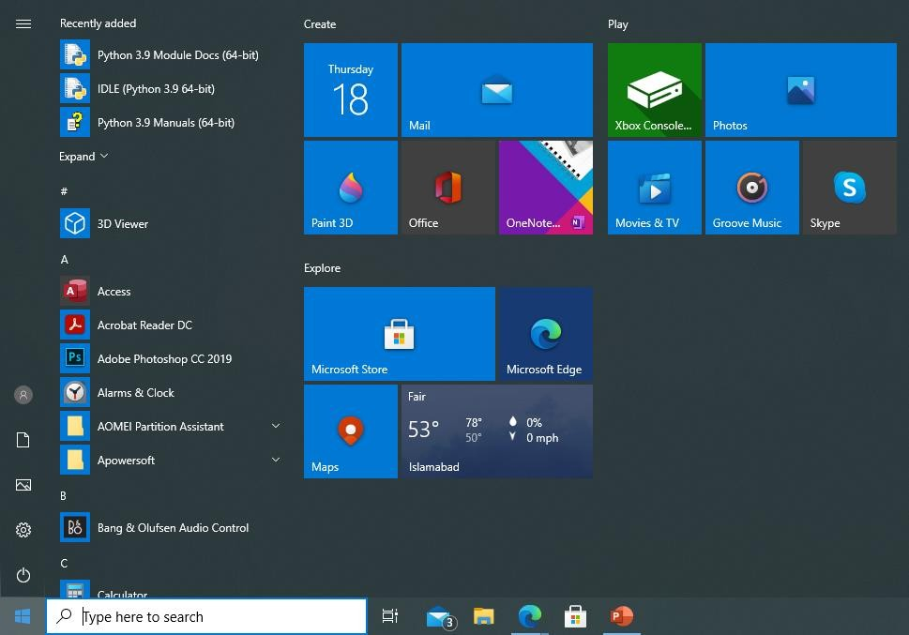

Slide 32
Other Editors

Slide 33
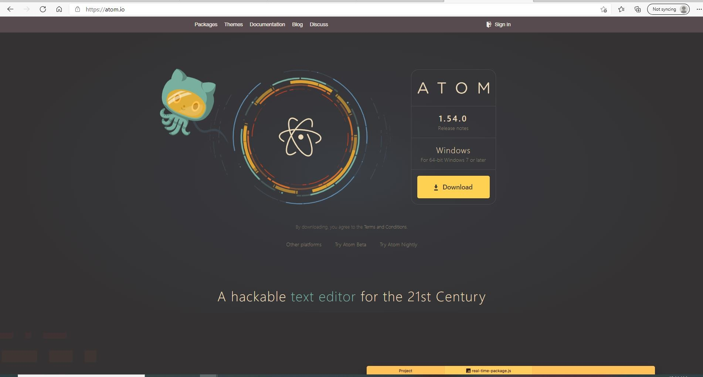

Slide 34
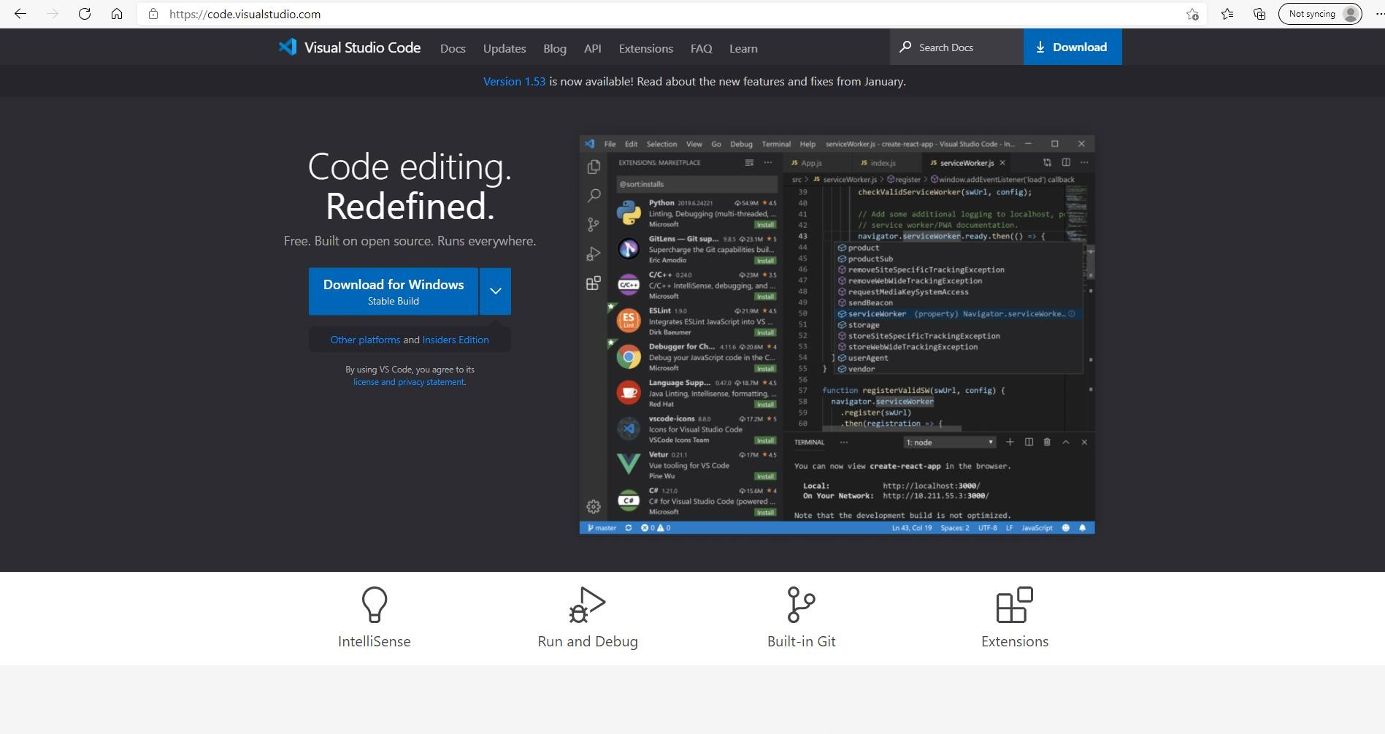

Slide 35
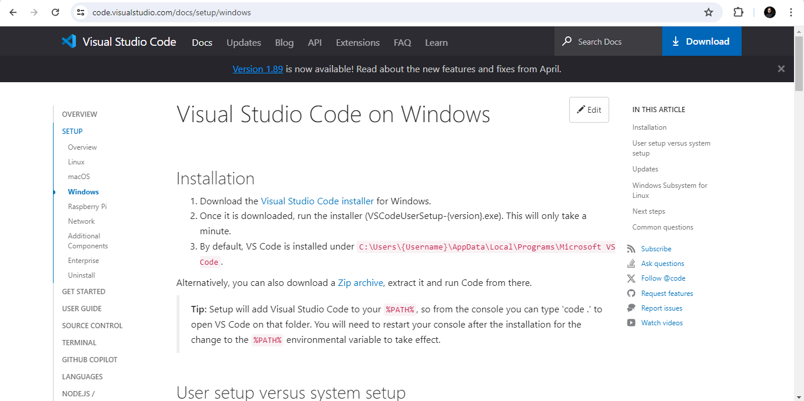

Slide 36
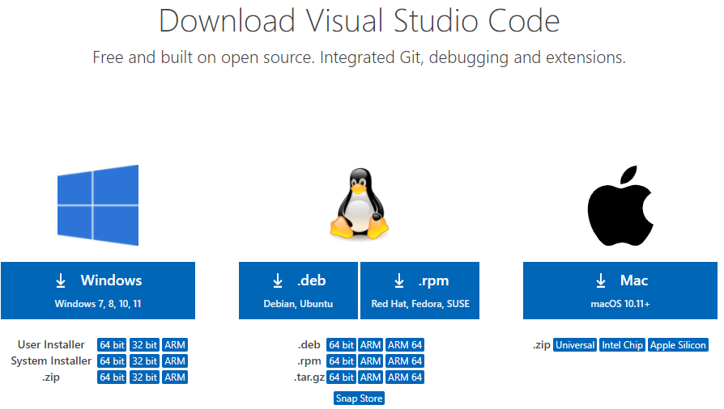

Slide 37
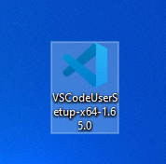
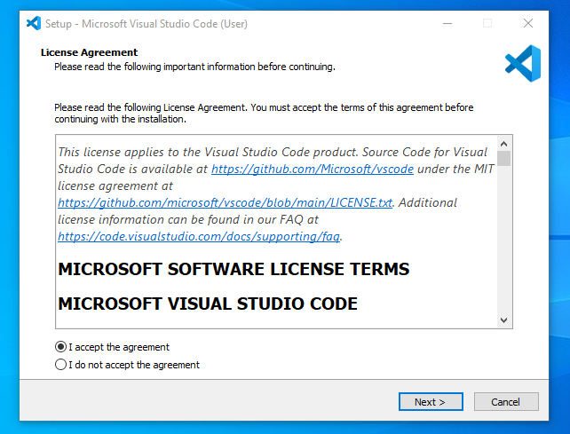
Click on the Installer icon to start the installation process of the Visual Studio Code.

Slide 38
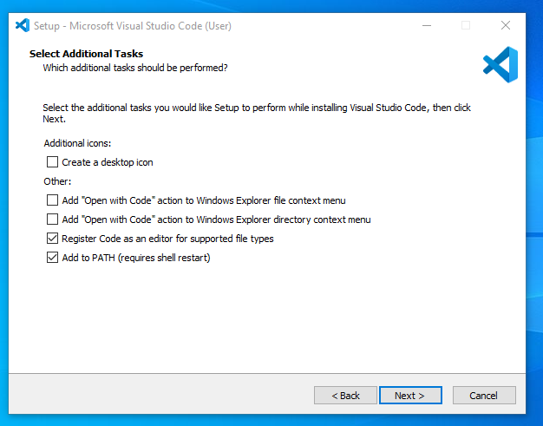

Slide 39
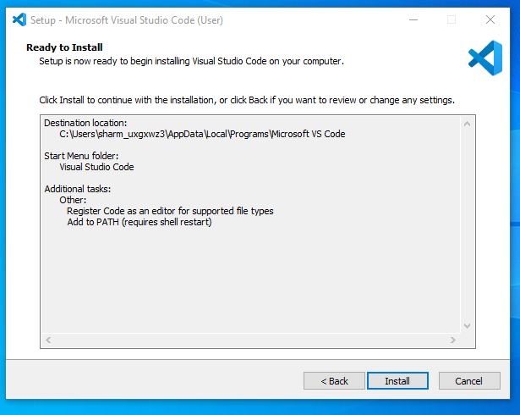
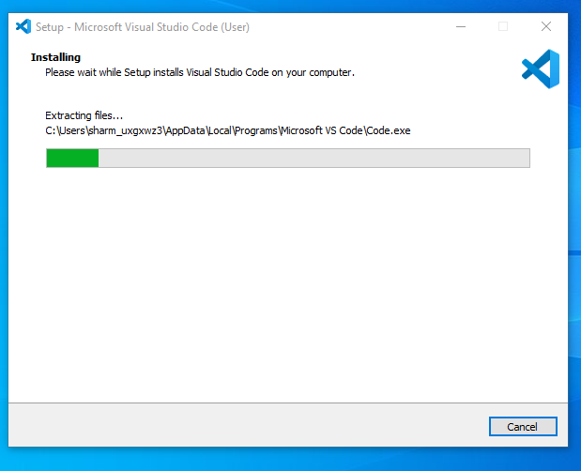

Slide 40
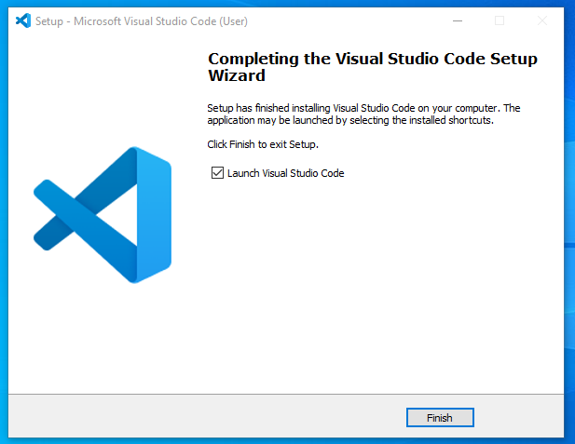

Slide 41
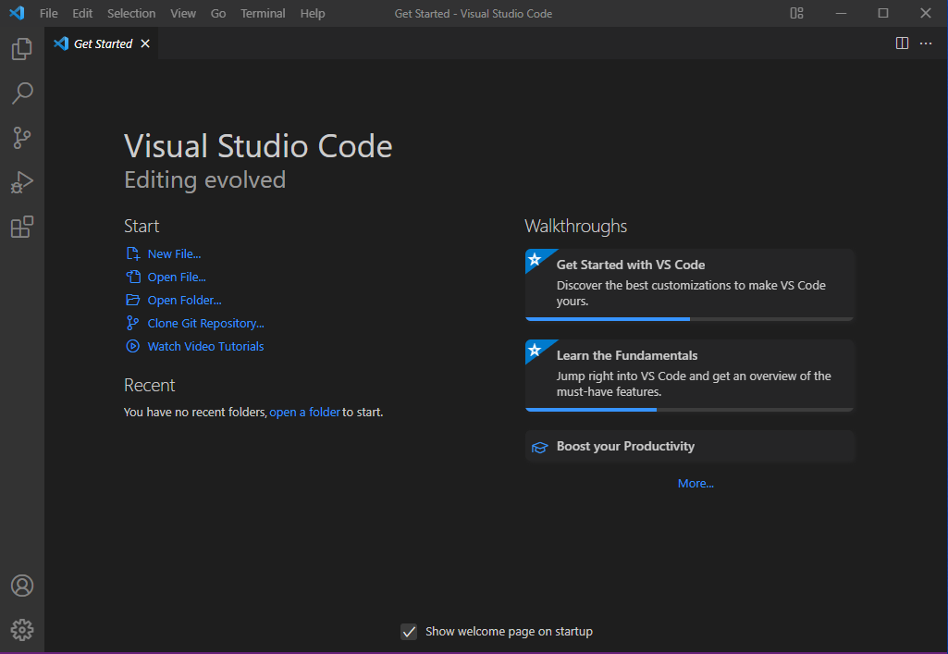

Slide 42
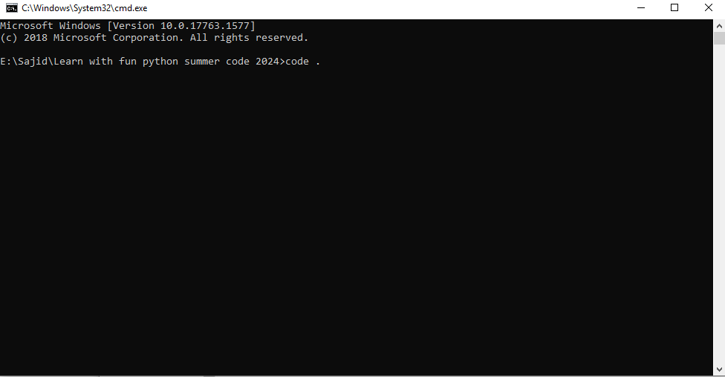
First move to your folder and then type

Slide 43
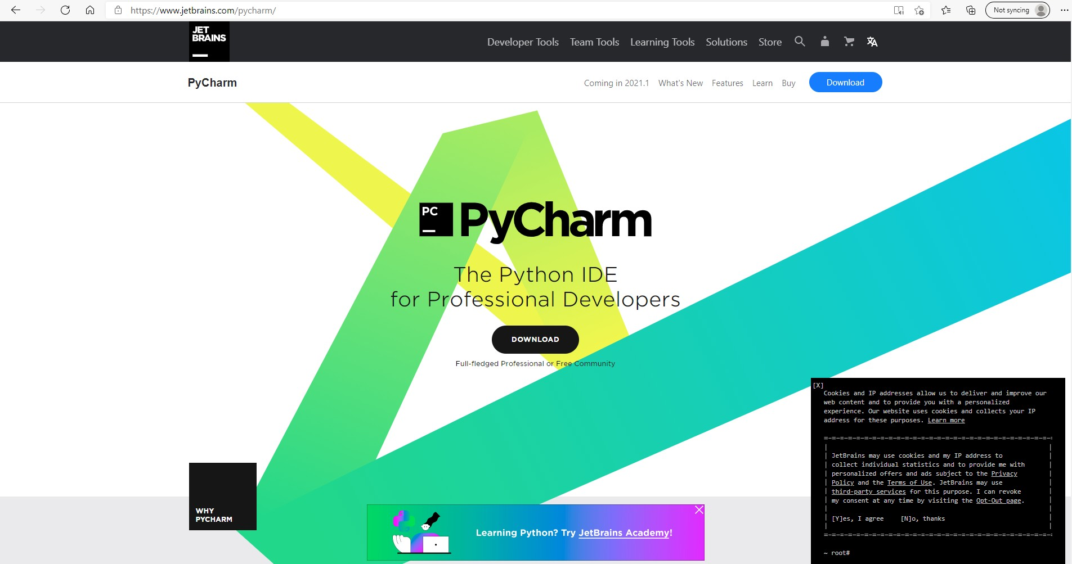

Slide 44
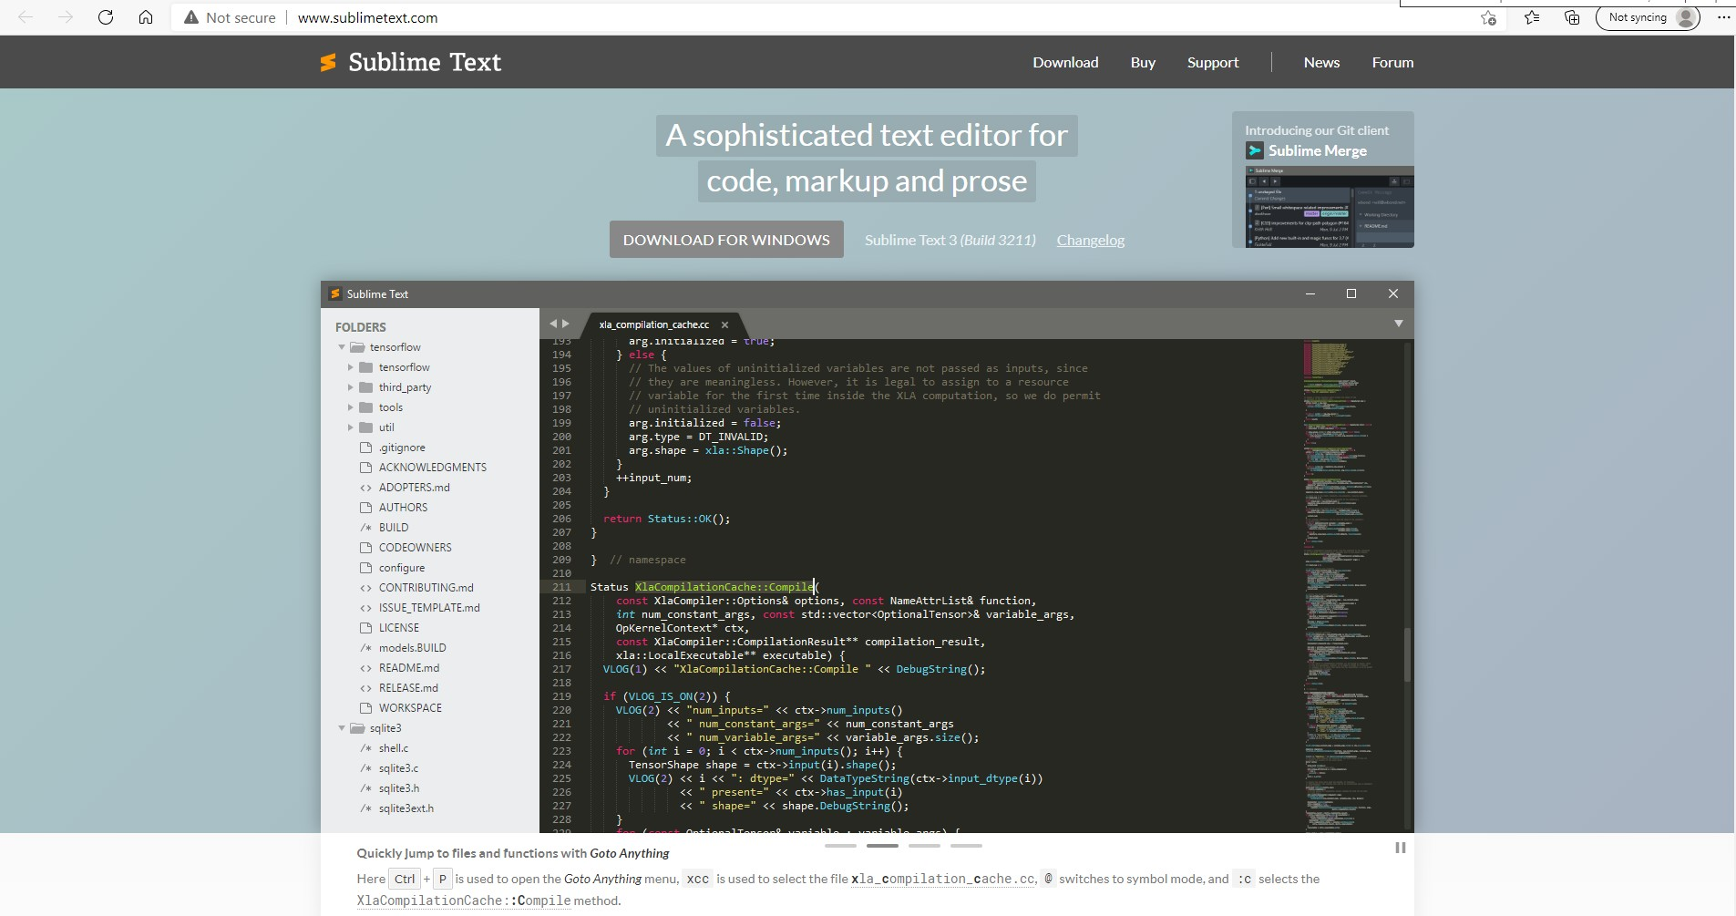

Slide 45
Some Exercises

Slide 46
Write a script that solves and shows the summation of 71 + 23.
Do the same as above, saving the numbers in variables and displaying
the answer as “Sum of X and Y is …. ”.
Ask the user to enter their Year of Birth. Then calculate and display their current age
Try to print the day, month, year in the form “Today is 20/02/2021”.
Generate two random integers between 1-20, perform any two mathematical operations on them, and print answers to screen
Take a screenshot of your code and output for record. We will be reviewing this in the next session

